Slide 1
Axure RP
Yuzhou FEng

Slide 2
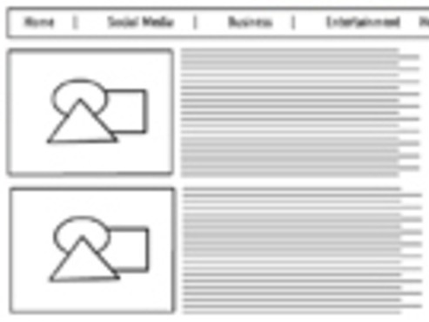

Why do we use prototype in Agile?
Development
Implement
Analysis
Design
Communication
Development Circle
Documentation
?

Slide 3
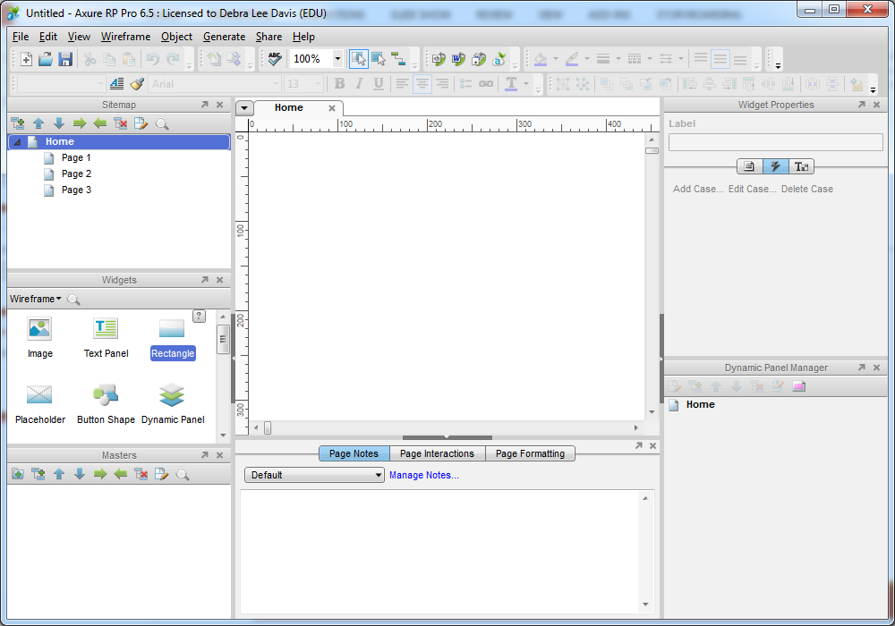

Axure RP

Slide 4
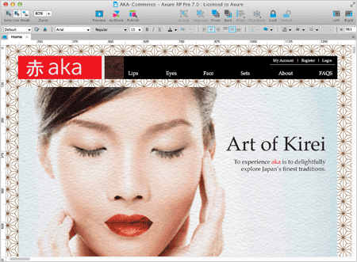
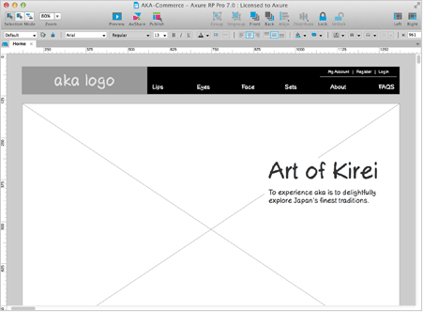
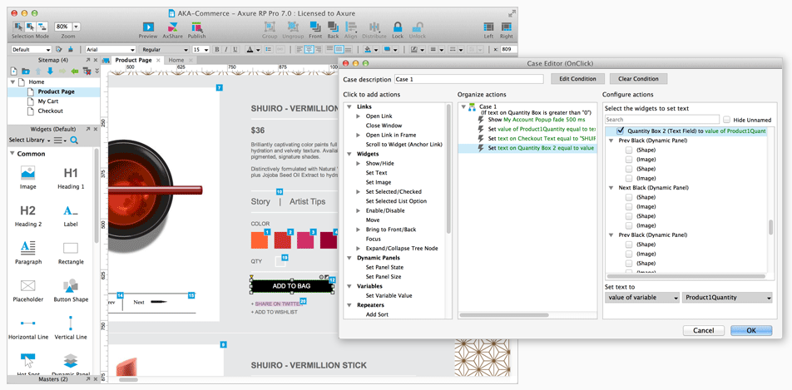
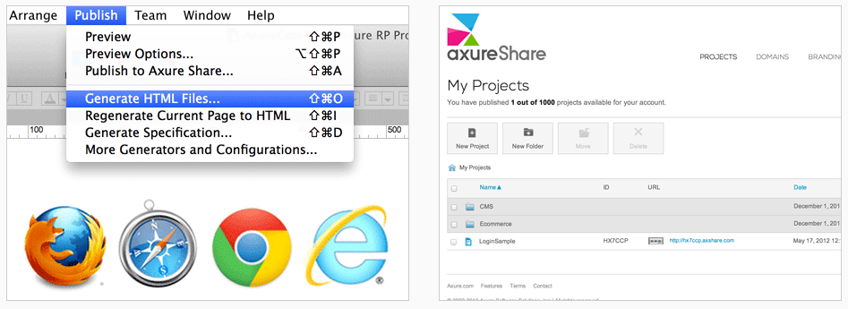
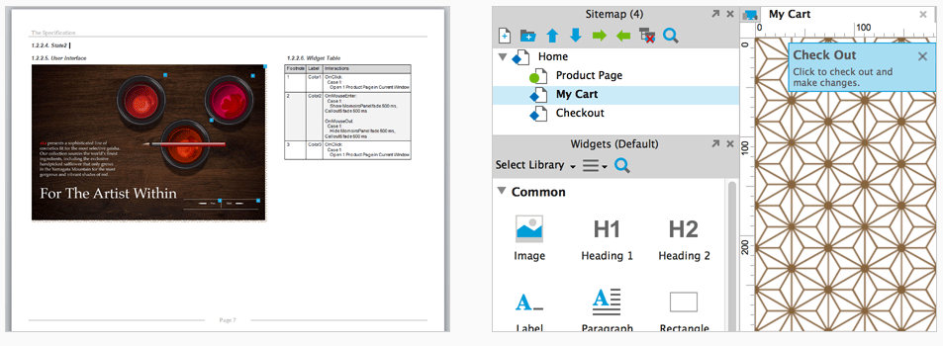
Features of Axure
From Sketch to Polished
Advanced Prototyping
Publish and Share
Documentation

Slide 5
Quick Start with Axure

Slide 6
Thanks
Yuzhou Feng

